Slide 1



Dental Clinic Management System

Slide 2
Team Members: Beshoy Amir George Mathew Magdy Saad

Slide 3
This module consists of several tables which make ability to create a new patient and record his information and medical history and schedule appointments for examination with the ability to confirm or cancel this appointment.
Module Objectives

Slide 4
Patient Table

Slide 5
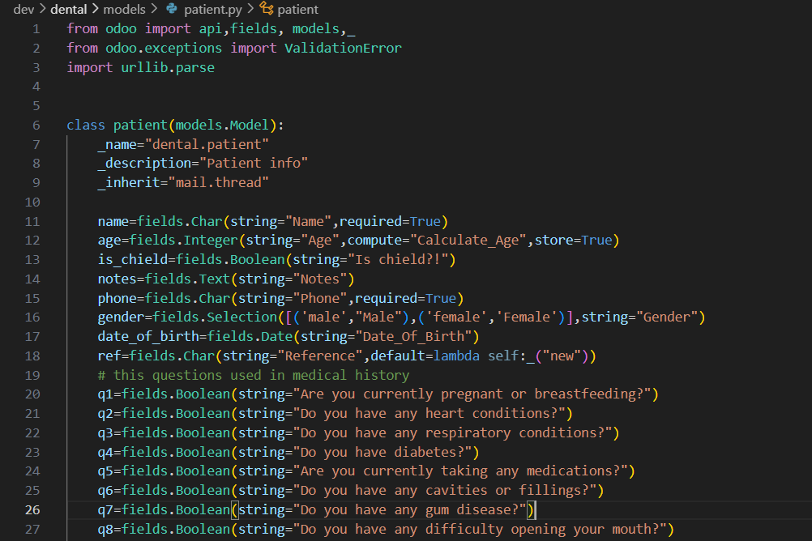
Patient Table(.py)

Slide 6
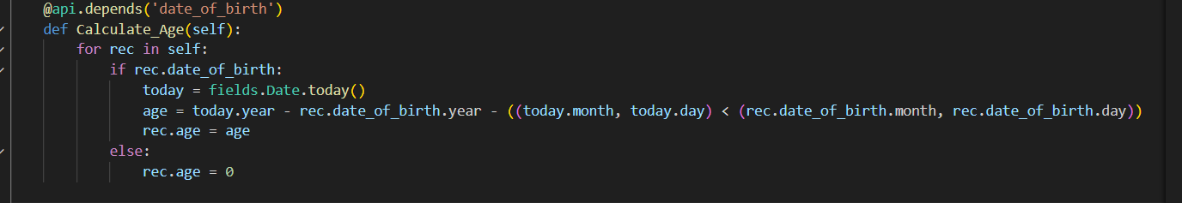
Patient Table(.py)
This function takes birth date from user and calculate his age.

Slide 7
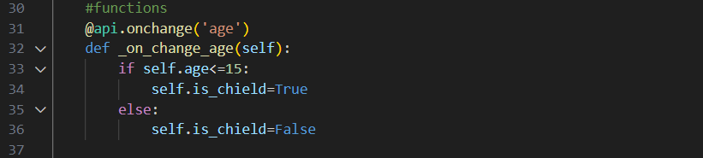
Patient Table(.py)
This function takes age and determine if the patient is child or not.

Slide 8
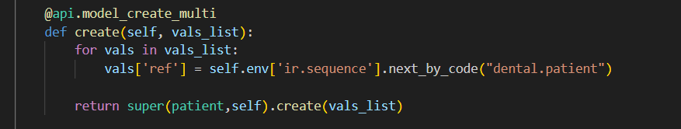
Patient Table(.py)
This function generates the reference.

Slide 9
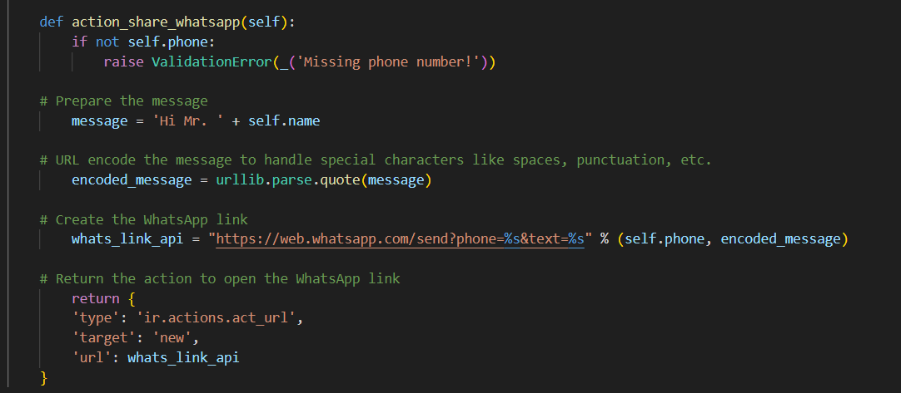
Patient Table(.py)
This function integrate WhatsApp to communicate patients using button in the tree view.

Slide 10
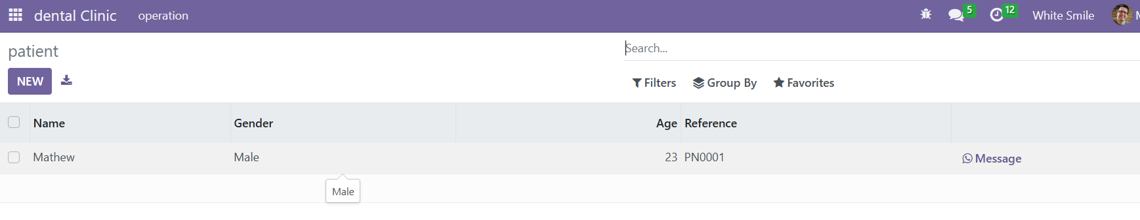

Slide 11
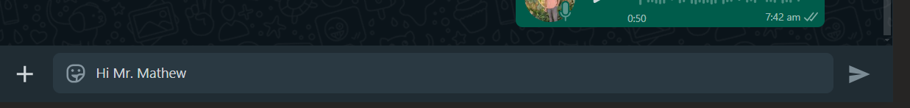

Slide 12
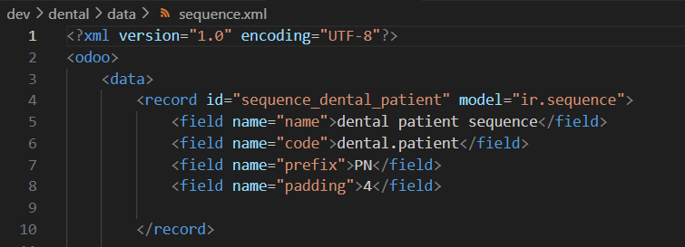
Sequence(.xml)
In this file we customize sequence details

Slide 13
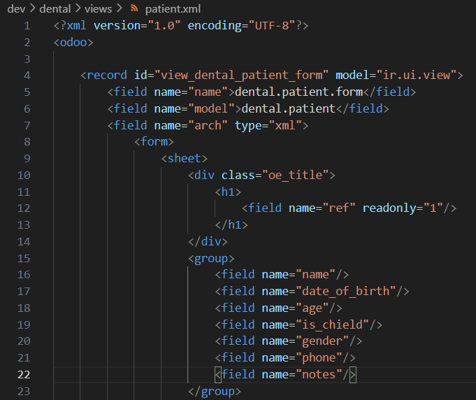
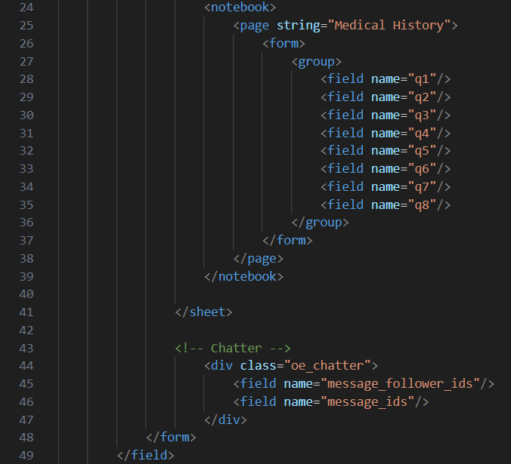
Patient-view(.xml) (Form)
In this part of file, we customize the way the table is displayed in the module as form.

Slide 14
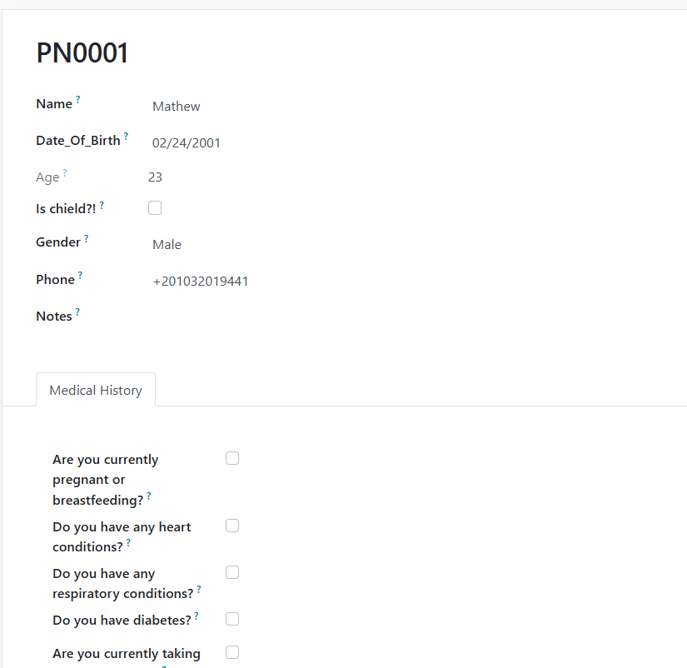
Department-view(.xml) (Form)
This screen show how file works the table is displayed in the module.

Slide 15
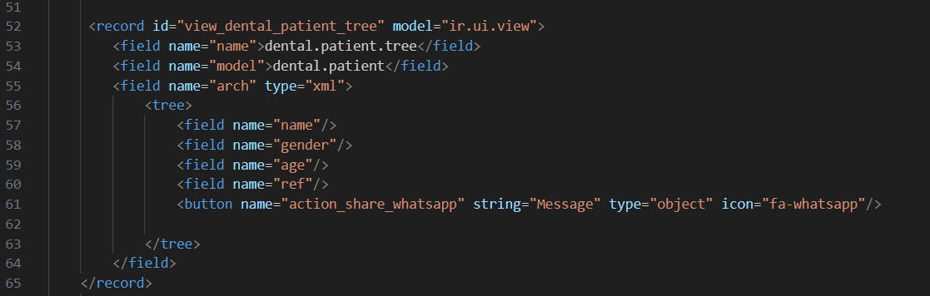
Patient-view(.xml) (Tree)
In this part of file, we customize the way the table is displayed in the module as tree.

Slide 16
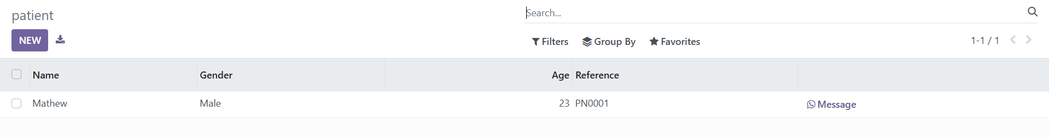
Department-view(.xml) (Tree)
This screen show how file works the table is displayed in the module.

Slide 17
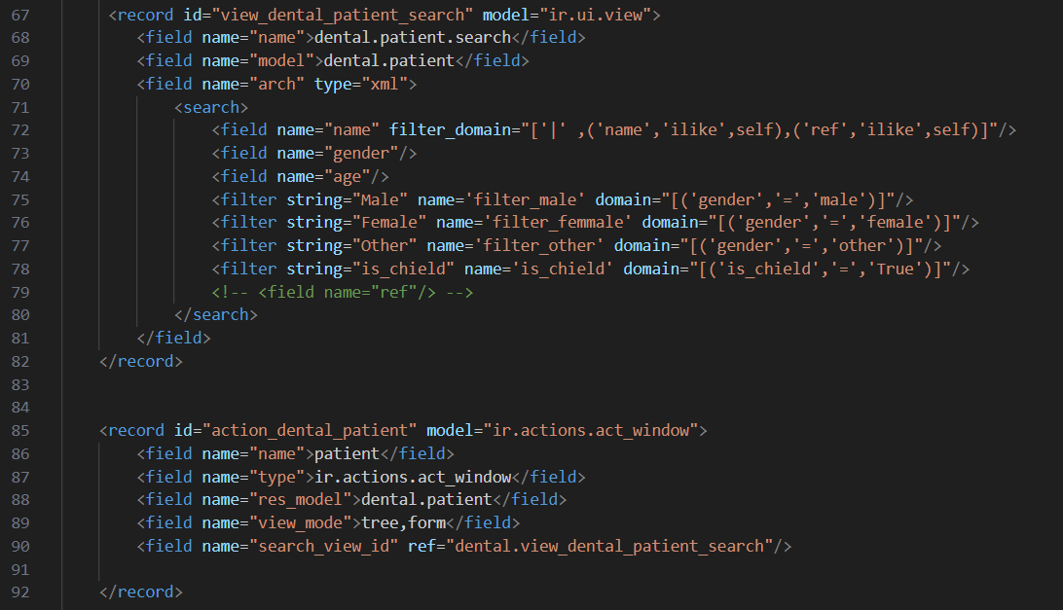
Patient-view(.xml) (Search)
In this part of file, we customize the way we will search with in this table in the module.

Slide 18
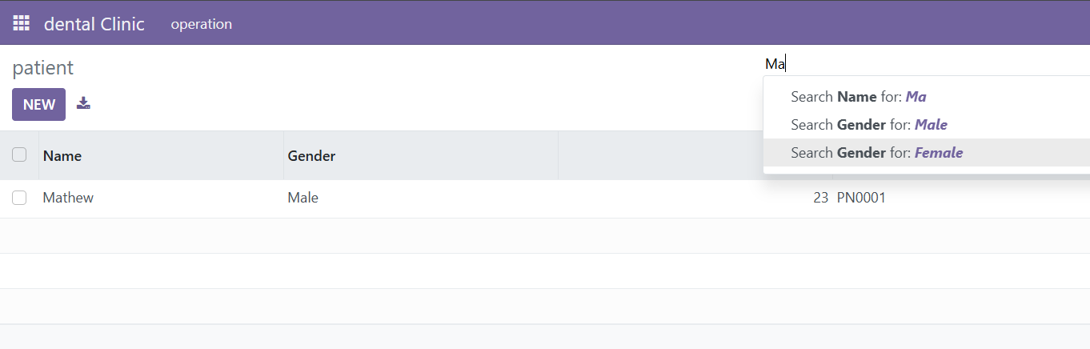
Patient-view(.xml) (Search)
This screen show how file works the table is displayed in the module.

Slide 19
Department Table

Slide 20
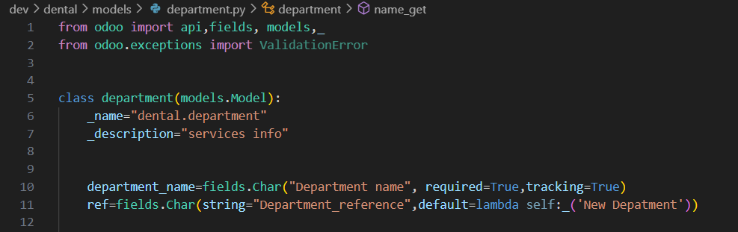
Department Table(.py)

Slide 21
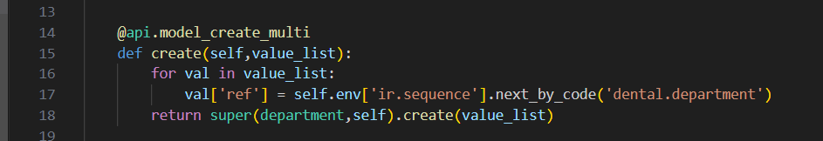
Department Table(.py)
This function generates the reference.

Slide 22
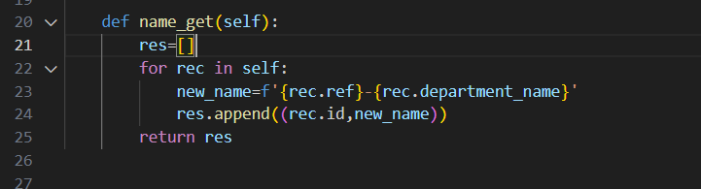
Department Table(.py)
This function generates a foreign key to use in another tables in relations.

Slide 23
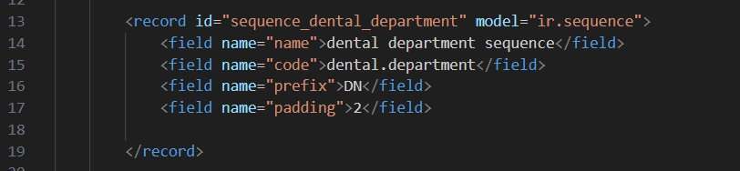
Sequence(.xml)
In this file we customize sequence details

Slide 24
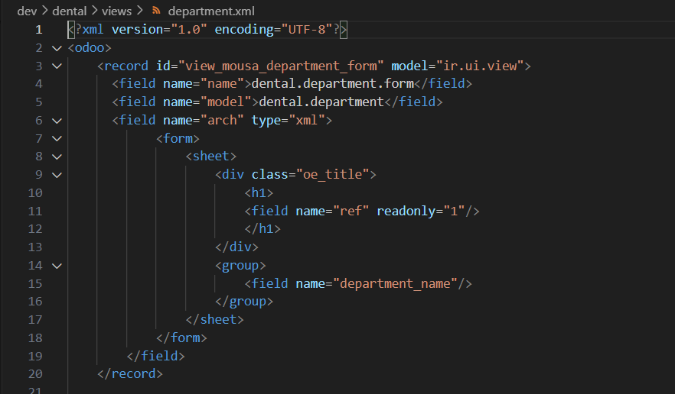
Department-view(.xml) (Form)
In this part of file, we customize the way the table is displayed in the module as form.

Slide 25
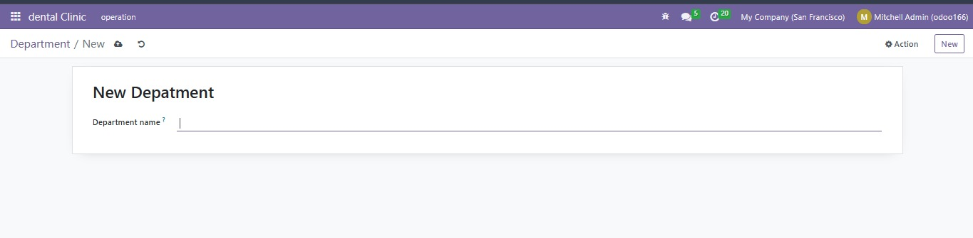
Department-view(.xml) (Form)
This screen show how file works the table is displayed in the module.

Slide 26
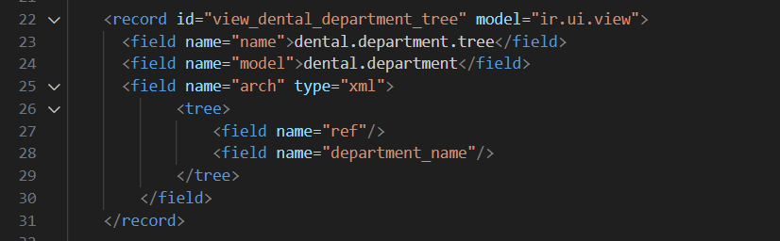
Department-view(.xml) (Tree)
In this part of file, we customize the way the table is displayed in the module as tree.

Slide 27
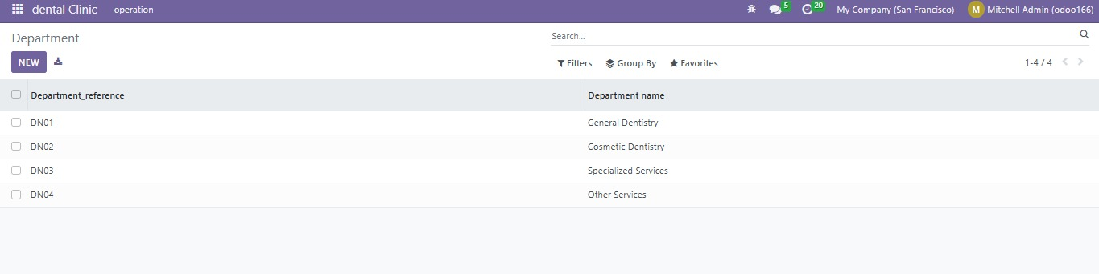
Department-view(.xml) (Tree)
This screen show how file works the table is displayed in the module.

Slide 28
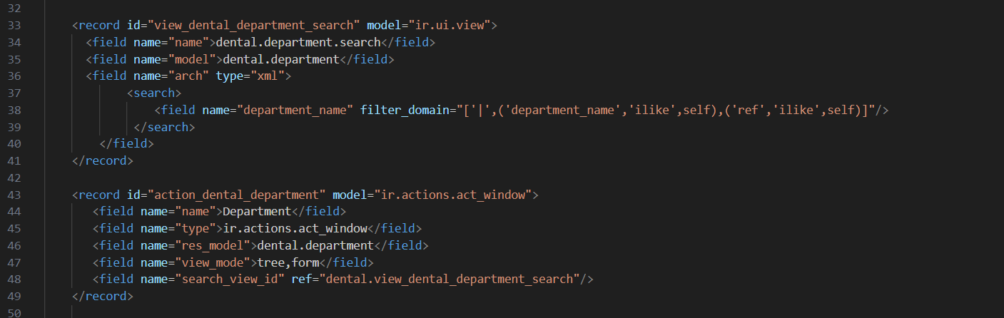
Department-view(.xml) (Search)
In this part of file, we customize the way we will search with in this table in the module.

Slide 29
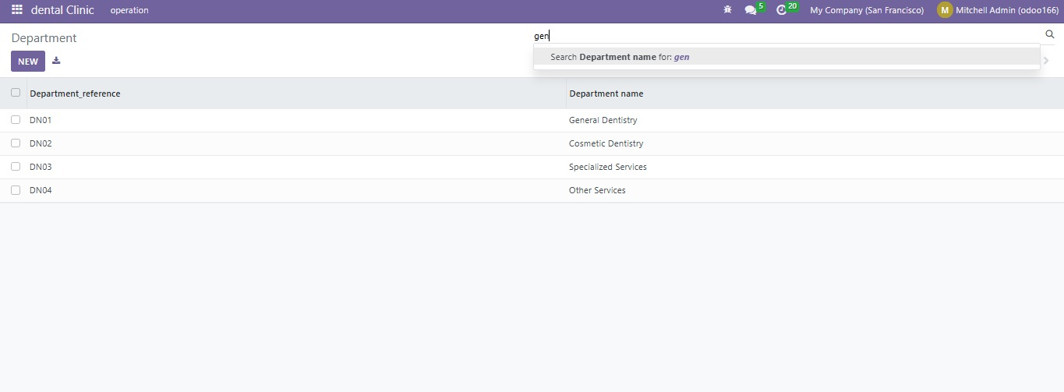
Department-view(.xml) (Search)
This screen show how file works the table is displayed in the module.

Slide 30
Services Table

Slide 31
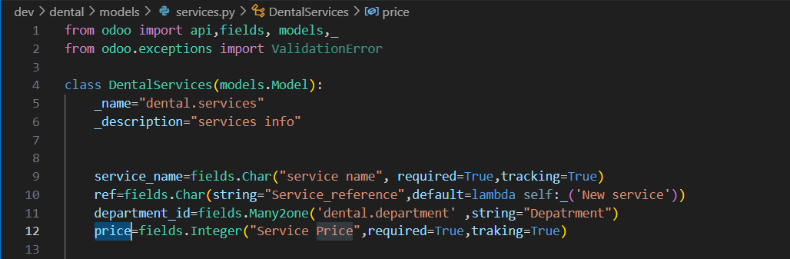
Services Table(.py)

Slide 32
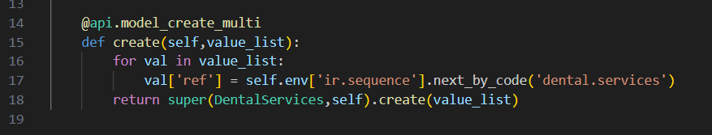
Services Table(.py)
This function generates the reference.

Slide 33
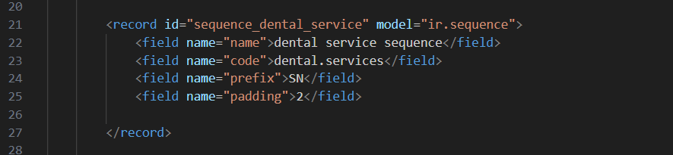
Sequence(.xml)
In this file we customize sequence details

Slide 34
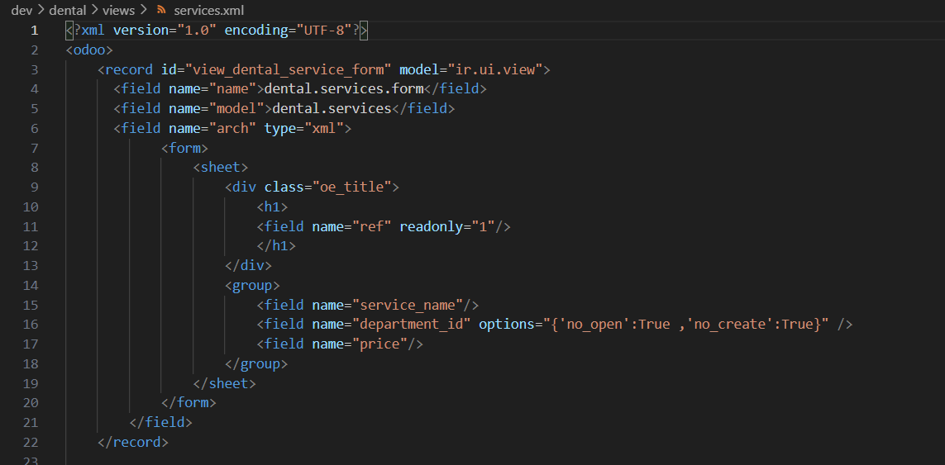
Services-view(.xml) (Form)
In this part of file, we customize the way the table is displayed in the module as form.

Slide 35
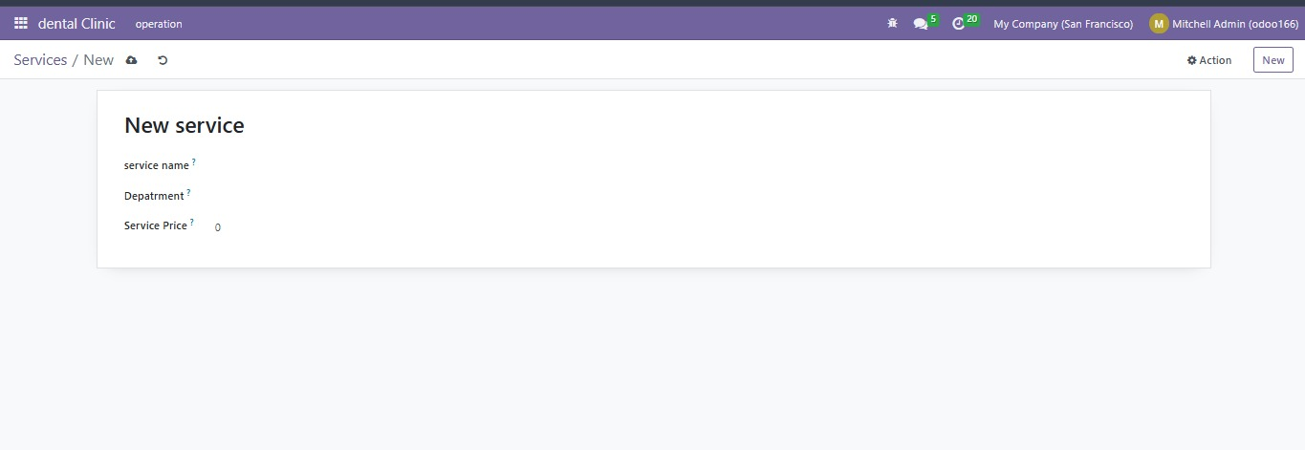
Services-view(.xml) (Form)
This screen show how file works the table is displayed in the module.

Slide 36
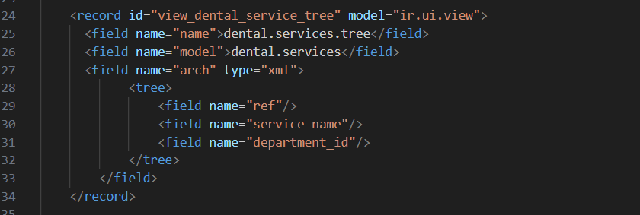
Services-view(.xml) (Tree)
In this part of file, we customize the way the table is displayed in the module as tree.

Slide 37
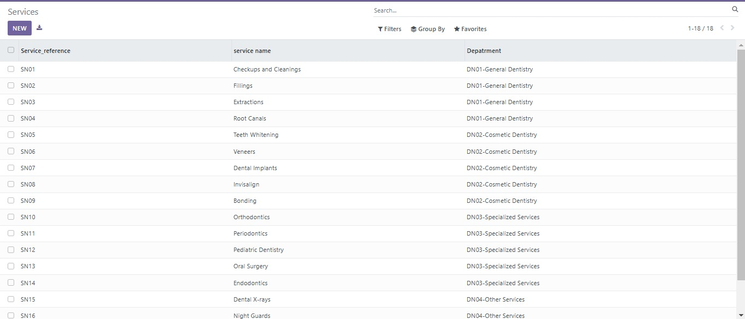
Services-view(.xml) (Tree)
This screen show how file works the table is displayed in the module.

Slide 38
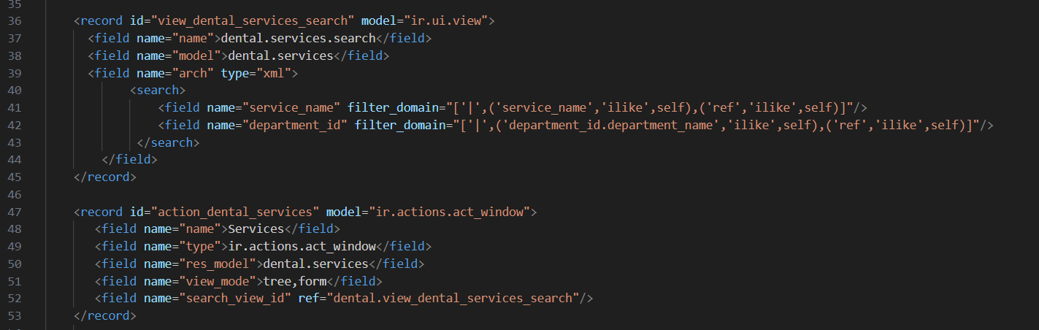
Services-view(.xml) (Search)
In this part of file, we customize the way we will search with in this table in the module.

Slide 39
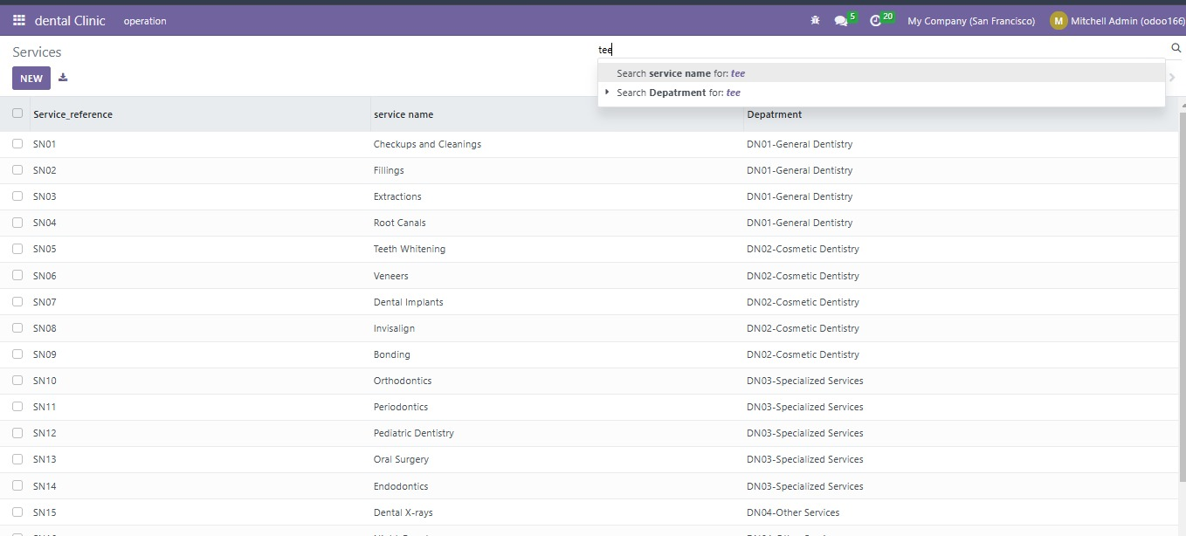
Services-view(.xml) (Search)
This screen show how file works the table is displayed in the module.

Slide 40
Appointment Table

Slide 41
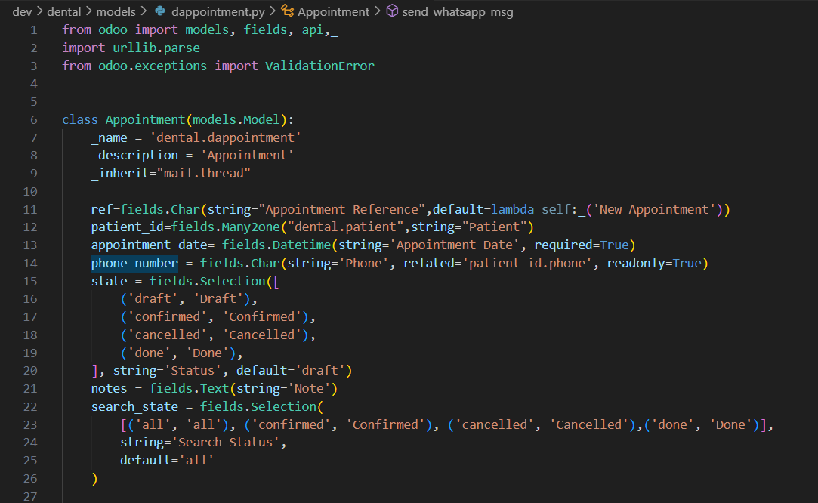
Appointment Table(.py)

Slide 42
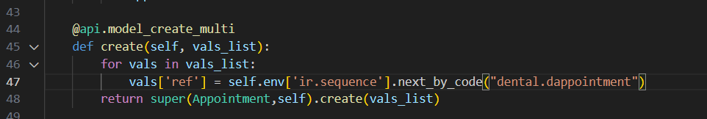
Appointment Table(.py)
This function generates the reference.

Slide 43
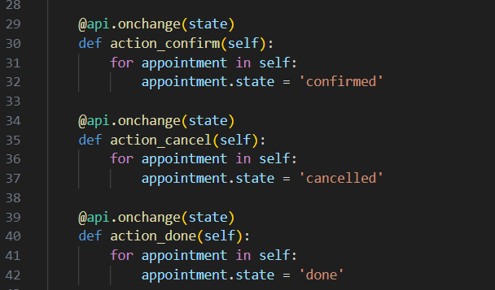
Appointment Table(.py)
These functions called in buttons in tree view to manage status.

Slide 44
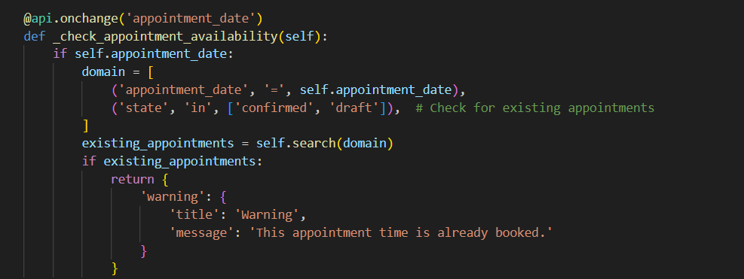
Appointment Table(.py)
This function checks if this appointment is booked or not.

Slide 45
Appointment Table(.py)
This function takes the patient name and the datetime of the appointment and pass them to a new exam form to start examination.

Slide 46
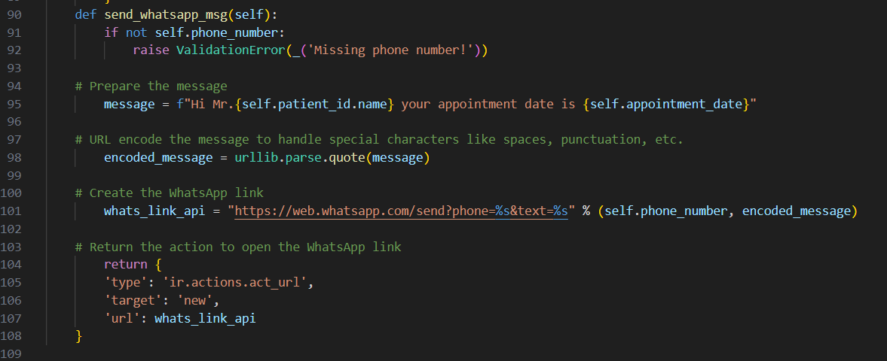
Appointment Table(.py)
This function integrate with WhatsApp to send a reminding message for the patient of his appointment.

Slide 47
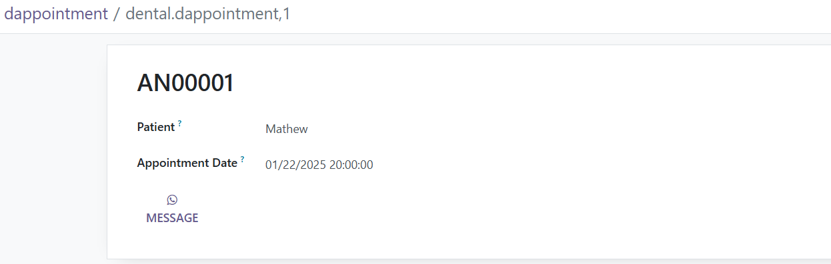

Slide 48
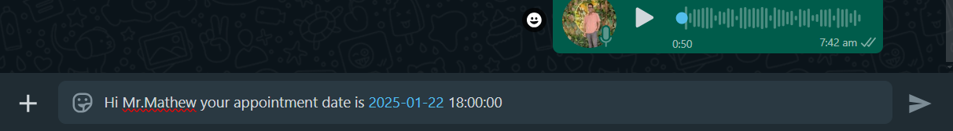

Slide 49
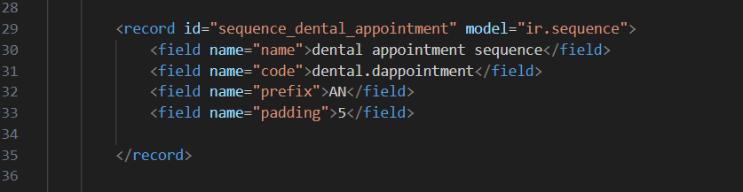
Sequence(.xml)
In this file we customize sequence details

Slide 50
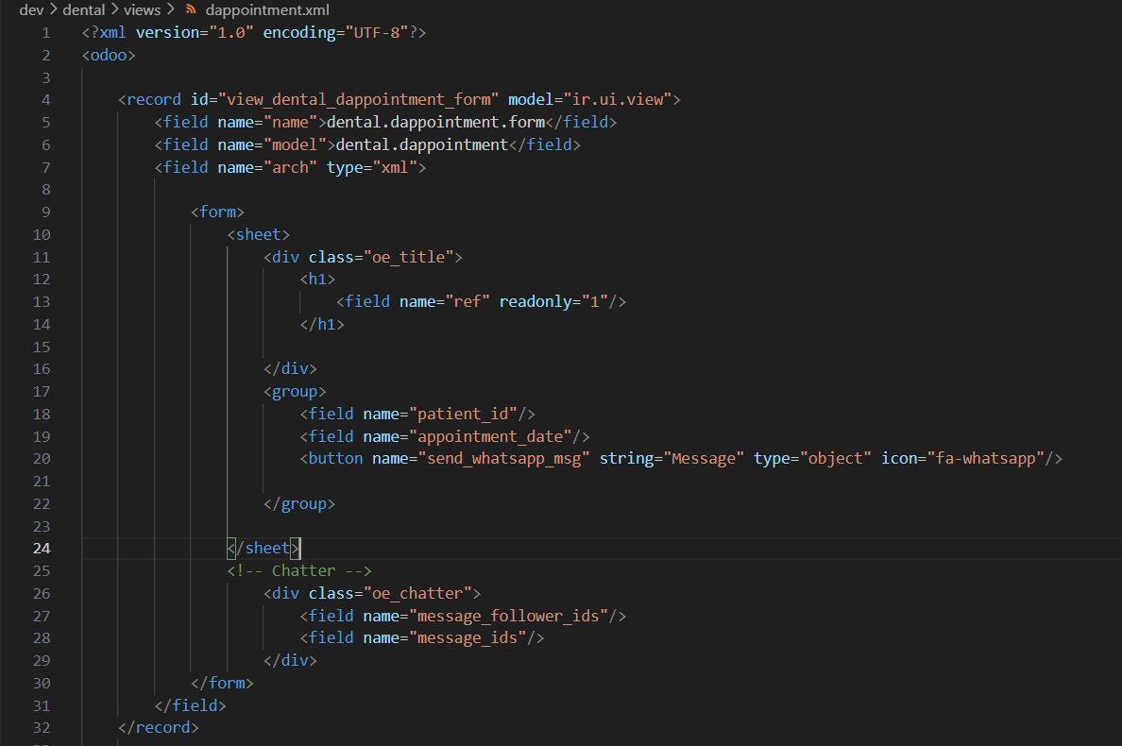
Appointment-view(.xml) (Form)
In this part of file, we customize the way the table is displayed in the module as form.

Slide 51
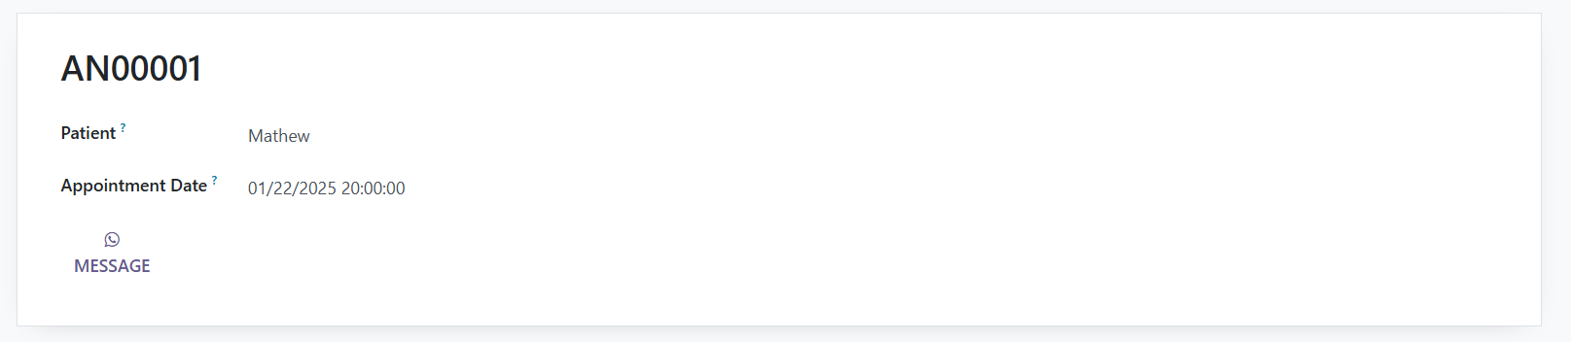
Appointment-view(.xml) (Form)
This screen show how file works the table is displayed in the module.

Slide 52
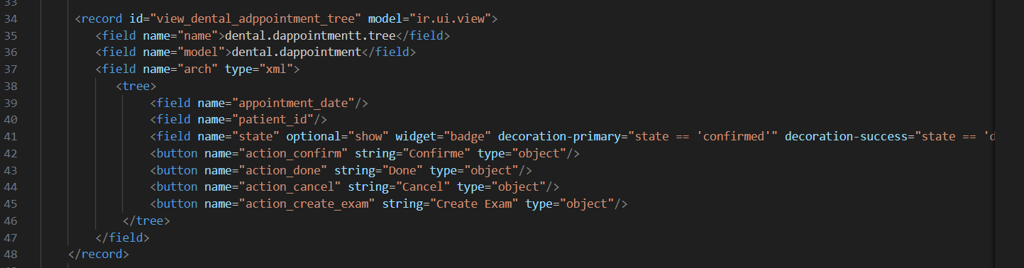
Appointment-view(.xml) (Tree)
In this part of file, we customize the way the table is displayed in the module as tree.

Slide 53
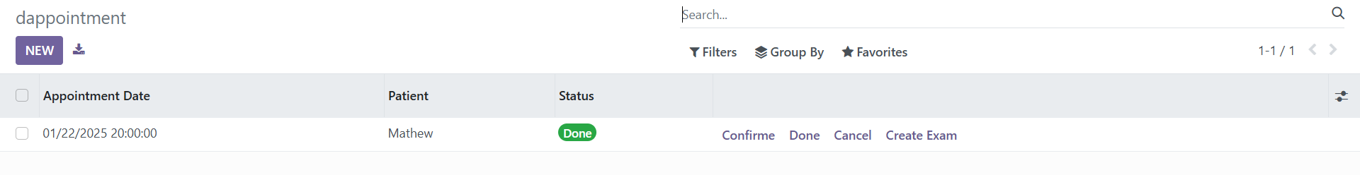
Appointment-view(.xml) (Tree)
This screen show how file works the table is displayed in the module.

Slide 54
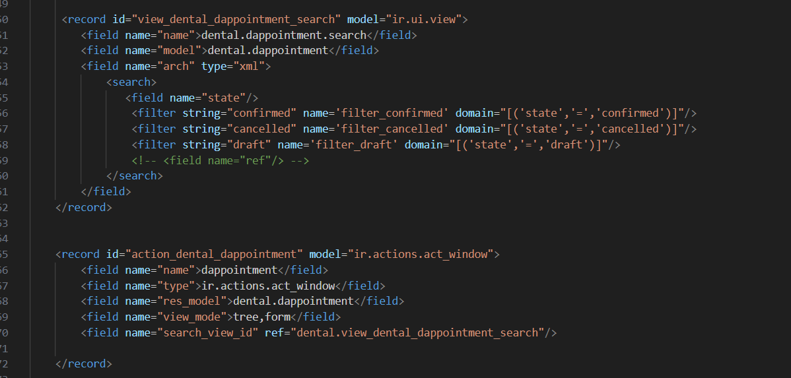
Appointment-view(.xml) (Search)
In this part of file, we customize the way we will search with in this table in the module.

Slide 55
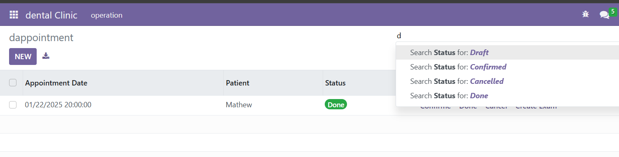
Appointment-view(.xml) (Search)
This screen show how file works the table is displayed in the module.

Slide 56
Examination Table

Slide 57
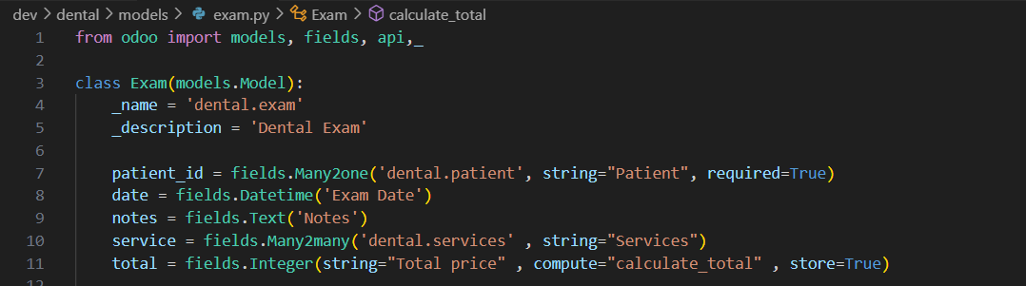
Examination Table(.py)

Slide 58
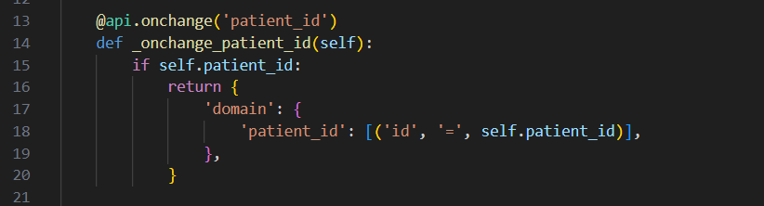
Examination Table(.py)
This function takes patient id from patient table.

Slide 59

Examination Table(.py)
This function calculate the total price of the services cost.

Slide 60

Examination Table(.py)
This function takes us to invoice module to pay the services total cost.

Slide 61

Examination Table(.py)

Slide 62

Examination Table(.py)

Slide 63

Examination-view(.xml) (Form)
In this part of file, we customize the way the table is displayed in the module as form.

Slide 64
Examination-view(.xml) (Form)
This screen show how file works the table is displayed in the module.

Slide 65

Examination-view(.xml) (Tree)
In this part of file, we customize the way the table is displayed in the module as tree.

Slide 66

Examination-view(.xml) (Tree)
This screen show how file works the table is displayed in the module.

Slide 67

Examination-view(.xml) (Search)
In this part of file, we customize the way we will search with in this table in the module.

Slide 68

Examination-view(.xml) (Search)
This screen show how file works the table is displayed in the module.

Slide 69
Manifest and Reports

Slide 70

Manifest Module file(.py)

Slide 71

Report(.xml)

Slide 72

Patient-card(.xml)

Slide 73

Patient-card

Slide 74

Services-card(.xml)

Slide 75

Services-card

Slide 76

Appointment-card(.xml)

Slide 77

Appointment-card

Slide 78
THANK YOU !

